Slide 1
Micro-Credit Defaulter Prediction using Machine Learning
By : Mrs. Swati Amit Motugade

Slide 2
Overview
Introduction to Micro Credit
Problem Statement
Data pre-processing
EDA
Feature Engineering
ML Model Building
AUC for Final Model
Conclusions on Predictions
Limitations and Future Scope

Slide 3

Introduction to Micro Credit
Microcredit is a common form of microfinance that involves an extremely small loan given to an individual to help them become self-employed or grow a small business. These borrowers tend to be low-income individuals, especially from less developed countries (LDCs). Microcredit is also known as "microlending" or "microloan."

Slide 4

Key Takeaways
Microcredit helps low-income individuals, including skilled laborers without the means to produce goods on their own, escape from poverty with small loans that help them buy the tools and materials. It improves the sustainability of their craft and gives them more independence.

Slide 5
Problem Statement
Telecom provider provide micro-credit on mobile balances to be paid back in 5 days.
Loan Varity :
1.Loan amount of 5 - Payback amount 6 (in Indonesian Rupiah)
2.Loan amount of 10 - Payback amount 12 (in Indonesian Rupiah)
Task is Build ML classification Model to Predict customer who might be defaulter based on independent features.

Slide 6
Dataset Information
Dataset provide by Fliprobo Technologies Ltd.
Micro Credit Defaulter dataset contain 209593 rows and 37 columns.
Out of all features only three features with object datatypes and rest are int64.
Data integrity check is perform for missing values, duplicate data, data error.
No missing values, whitespaces, ‘NA’, ‘-’ are present in dataset.

Slide 7
Data Pre-processing
Our dataset contains some negative values. To handle this problem we made an assumption that all negative values are typing errors happened accidentally.
To resolve this error we made the correction by taking absolute values of all negative values.
Also, we done feature engineering on the ‘pdate’ feature which was showing the date. Here we extracted new features like Day, Month and Year from the ‘pdate’ feature and then dropped the original feature.

Slide 8
Data Pre-processing
Also, there is an error in feature ‘maxamnt_loans30’ that the maximum value of this column is not reliable.
The given information says that maximum loan amount is 12.
So, we replaced value which are greater than 12 into the category of 0.
Dropped the unnecessary features like ‘Unnamed: 0’, ‘msisdn', 'pcircle’.
Also, found that the data is for the same year 2016. Hence dropped the newly extracted feature ‘Year’.

Slide 9
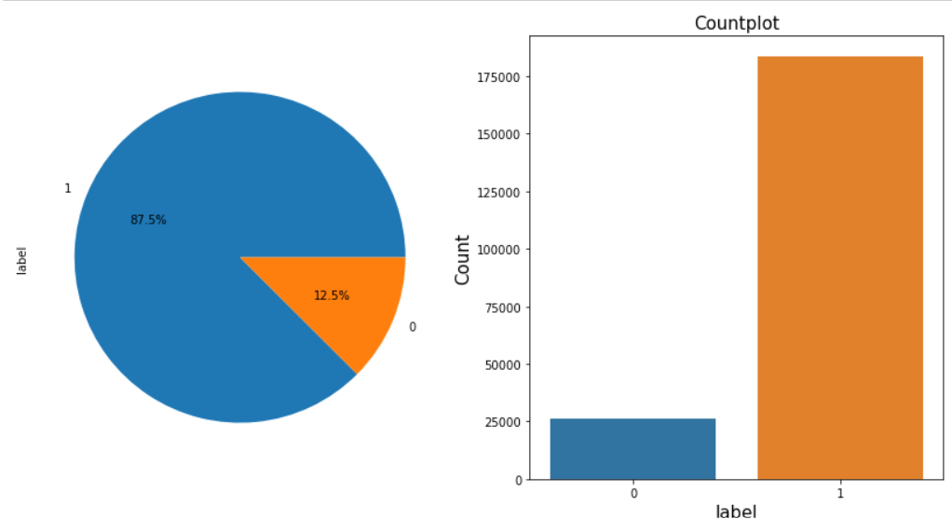
EDA Distribution of Target variable ‘label’
Label value ‘1’ represents non-defaulter user while Label value ‘0’ represents defaulter user.
Only 12.5% users are defaulters.
Target Variable Label is highly imbalanced in nature.
We have to balance the target variable before making predictions

Slide 10
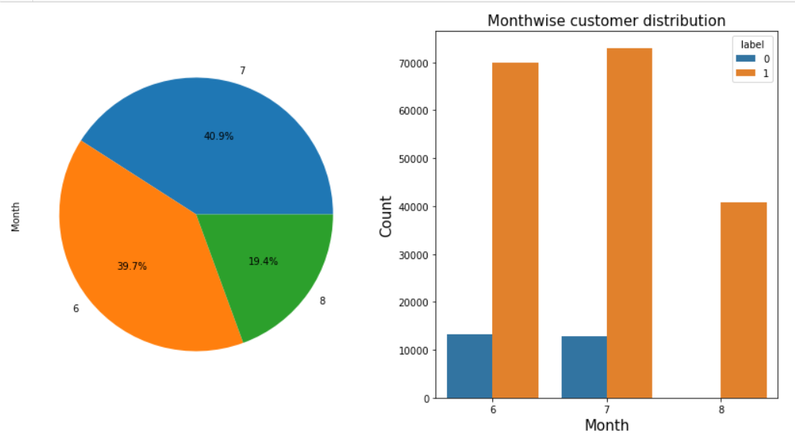
EDA Month vs defaulter distribution
Most of data belong to month 6 and 7, followed by month 8.

Slide 11
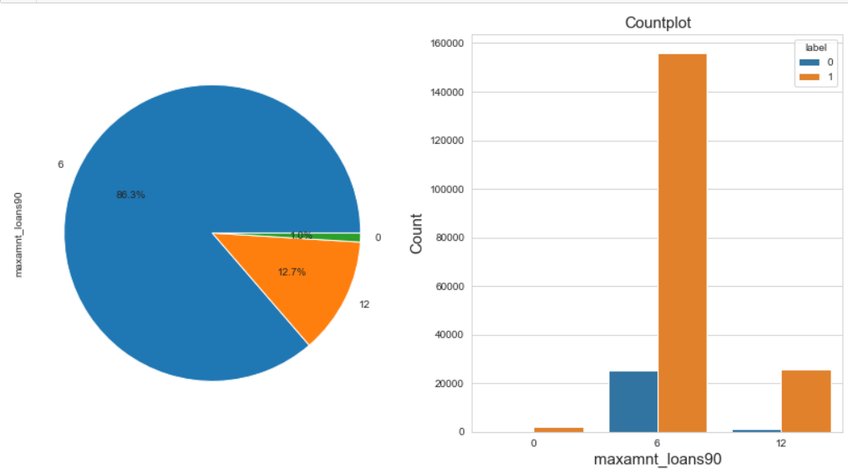
EDA Maximum amount of loan taken by users
In 30 & 90 days, maximum number of people had taken 6Rs as the loan amount.
Customers have less tendency to take loan in amount of 12.
There are very few people who do not taken loan.

Slide 12
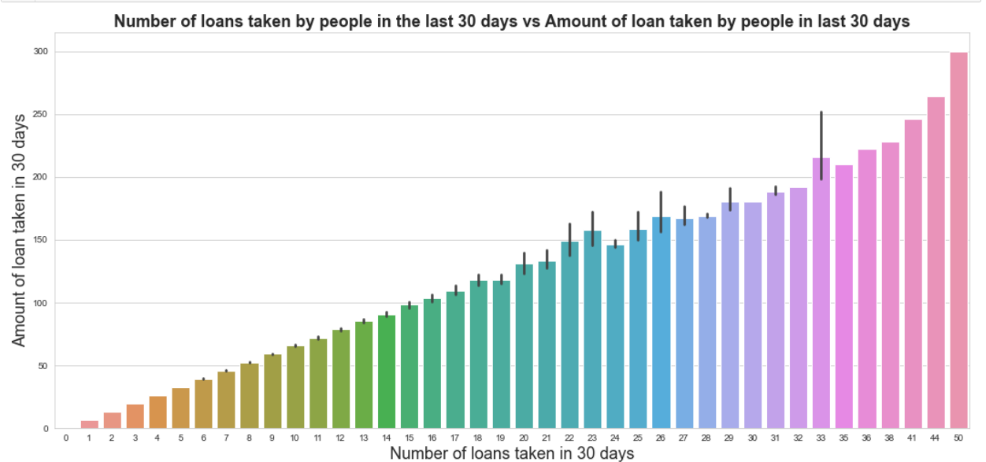
EDA Number of loan taken by customers in 30 days vs Amount of loan taken in 30 days
Maximum number of times loans taken by the people is 50 and the Average loan amount is equivalent to 300

Slide 13
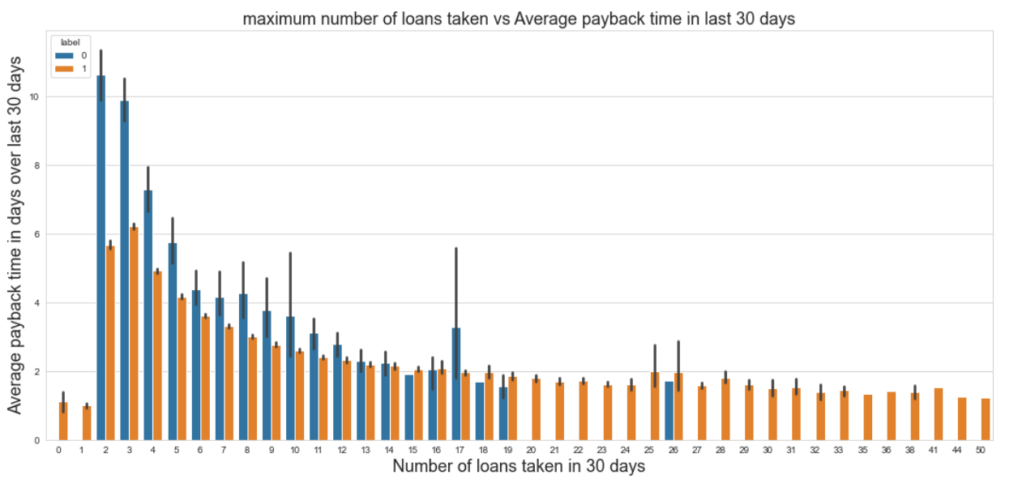
EDA Maximum Number of loan taken VS Average payback time in last 30 days
Average payback time over last 30 days is higher for people who had taken loan 2 times.

Slide 14
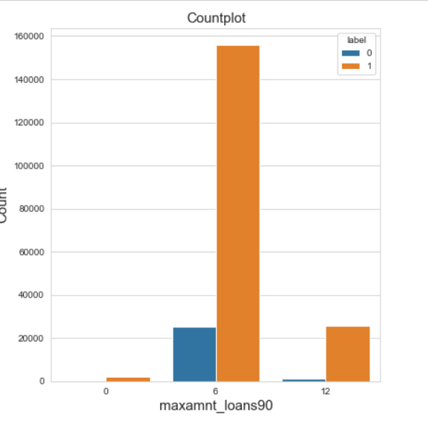
EDA Number of loan taken by customers in 30 days
Very few defaulters in case of customers who have taken loan in amount of 12.

Slide 15
Feature Engineering Outliers detection & removal
Outliers exists in only upper bound of the feature and not in lower bound.
So we used the Quantile based Flooring-Capping method to remove outliers.
Flooring is performed at 0th percentile for lower bound and capping perform at 99th percentile for upper bound.
Data loss while removing outliers is 5.44%.

Slide 16
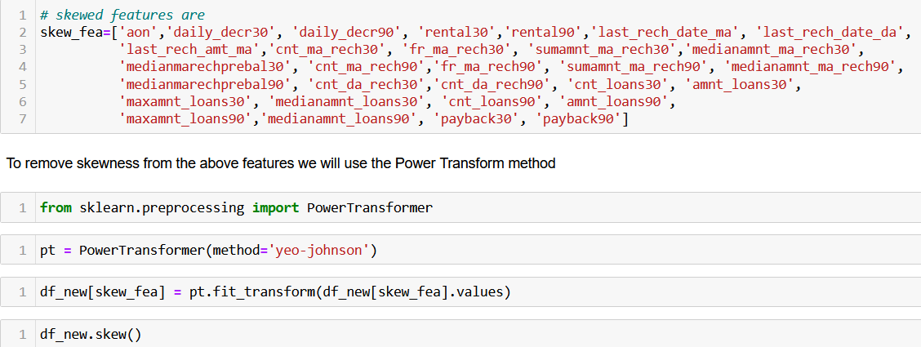
Skewness
Considerable amount of skewness exist in different features.
Yeo-Johnson Power Transformation used to reduce skewness.

Slide 17
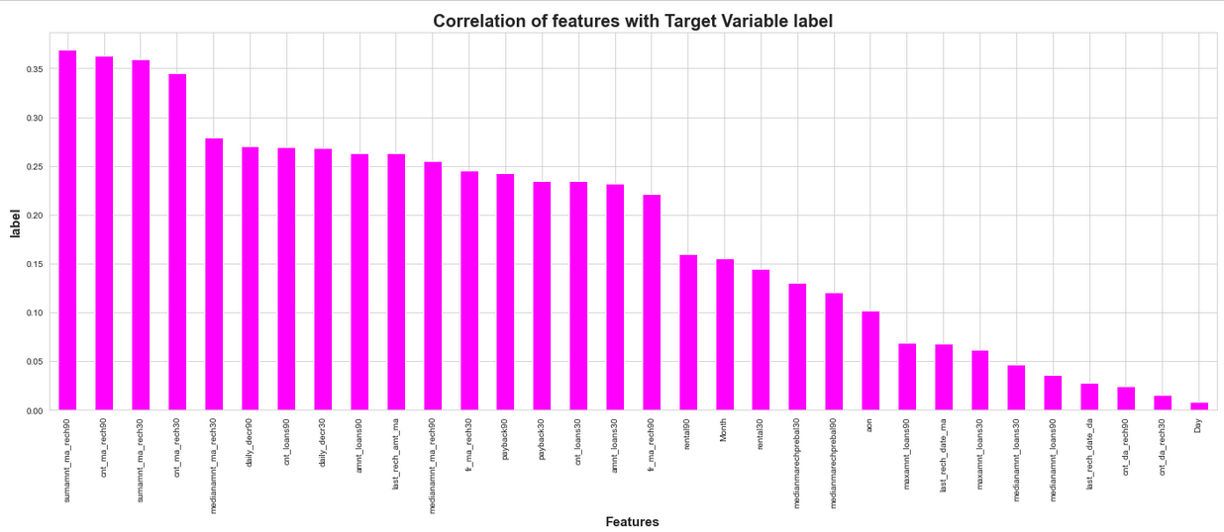
Correlation
The highly correlated features are sumamnt_ma_rech90, cnt_ma_rech90, sumamnt_ma_rech30 and cnt_ma_rech30.
The lowest correlated feature is Day.
From the above correlation graph it is clear that there is no negative correlation between any feature and target.

Slide 18
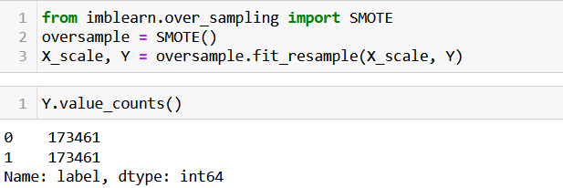
Handling of Imbalanced data
Target Variable label is Imbalanced in nature.
SMOTE techniques used to oversample minority class.

Slide 19
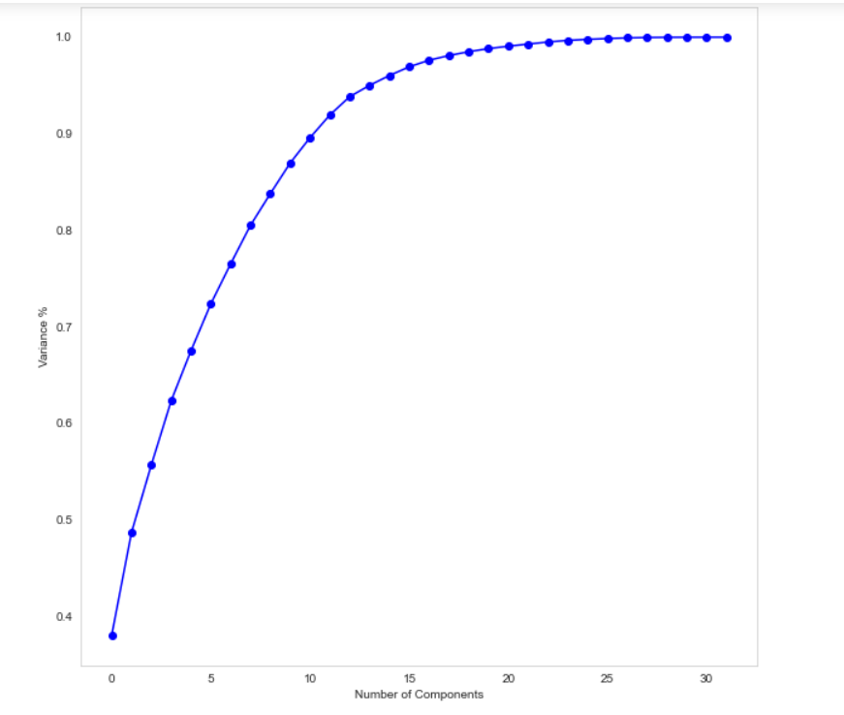
Multicollinearity and PCA
Multicollinearity exist between few features.
To resolve it PCA is applied.
Eleven principal components attribute for 90% of variation in the data.
PCA applied for Eleven components.

Slide 20
MODEL BUILDING
Objective is to predict customer is defaulter or not. It can be solve by application of classification ML algorithm.
Different Classification algorithm used to train model, in order to have maximum accuracy score.
Machine learning classification algorithms used in this project are –
Logistics Regression
Decision Tree Classifier
Random Forest Classifier
K-Neighbours Classifier
Extra Tree Classifier

Slide 21
Model Evaluation Summary
Random Forest Classifier gives maximum accuracy score and cross validation score.
Hyper parameter tuning perform on this model to gain more accuracy.
Algorithm | Accuracy Score | CV Score
Logistic Regression | 0.7659040 | 0.762442
Random Forest Classifier | 0.919530 | 0.929915
Decision Tree Classifier | 0.857470 | 0.868546
K-Neighbours Classifier | 0.891013 | 0.900608
Extra Tree Classifier | 0.935749 | 0.943825

Slide 22
Hyperparameter OPtimization
Since, Random Forest Classifier gives us best accuracy score with minimum difference between accuracy score and cross validation score, we select Random forest classifier as our final model and performed hyperparameter optimization with this model.
The accuracy score after hyperparameter optimization is 0.768123.

Slide 23
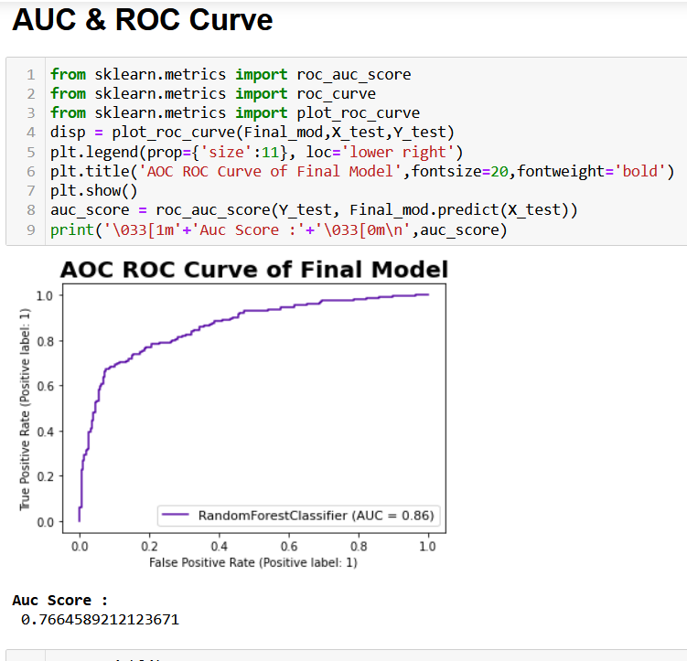
AUC & ROC Curve
AUC Score for Random Forest classifier is 0.86

Slide 24
Limitations & Scope for Future OF THIS Work
Limited computational resources put limitation on optimization through hyper parameter tuning. Accuracy of model can increase with hyperparameter tuning with several different parameter. Here we use only two parameters for tuning.
Data is imbalanced, we utilised SMOTE for it but if get label data which at least in ratio of 70:30, It can give us much more realistic model.

